Slide 1

LOGICAL FUNCTIONS IN EXCEL
IFS FUNCTION
COUNTIFS
SUMIFS
AVERAGEIFS
MAXIFS
MINIFS
IF FUNCTION
SUMIF
AVERAGEIF
COUNTIF

Slide 2
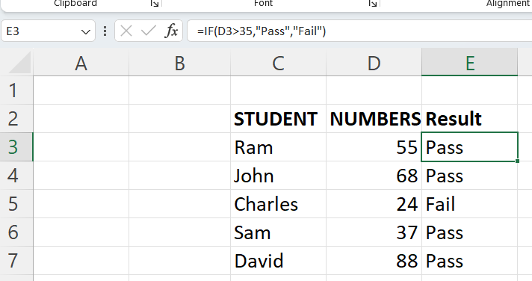
IF FUNCTION
The IF function is a premade function in Excel, which is used to return the values based on a true or false condition.
Syntax: =IF(logical_test,[value_if_true],[value_if_false])

Slide 3
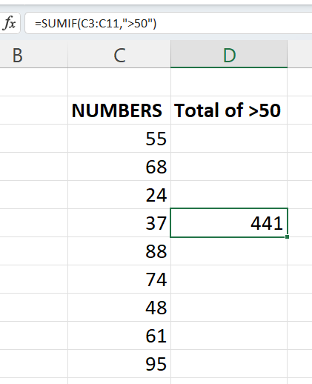
SUMIF FUNCTION
SUMIF is a built-in function in Excel which calculates the sum of values
in a range based on true or false condition.
Syntax: =SUMIF(range, criteria, [sum_range])

Slide 4
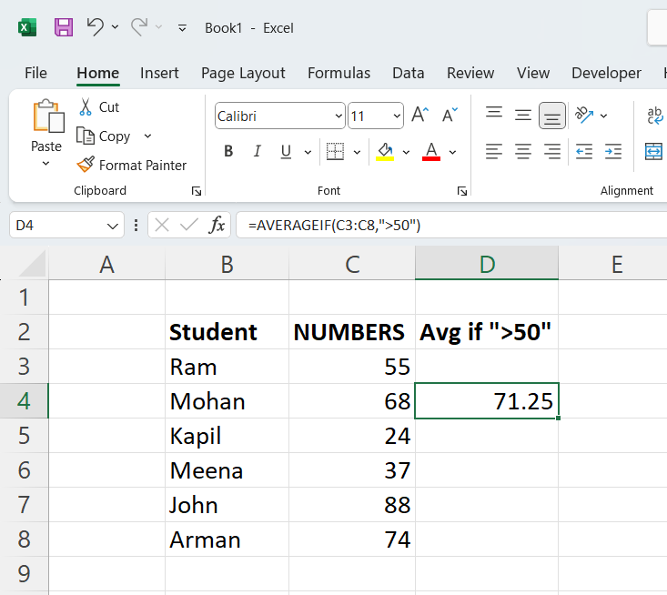
AVERAGEIF FUNCTION
AVERAGEIF function is an Excel statistical function which calculates the average of a given range of cells by a specific criteria.
Syntax: =AVERAGEIF(range, criteria,[average_range])

Slide 5
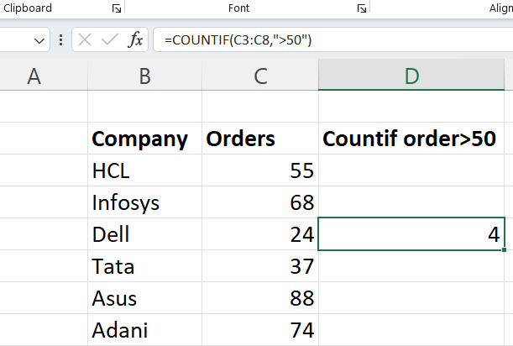
COUNTIF FUNCTION
COUNTIF function is a premade function in Excel, which counts cells as specified. This function counts the cells with both Alphabetical and Numerical entries.
Syntax: =COUNTIF(range, criteria)

Slide 6
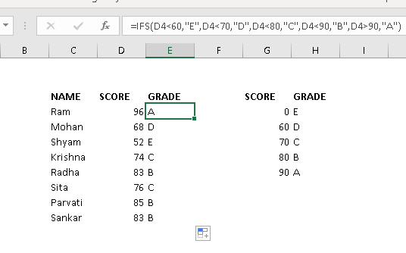
IFS FUNCTION
The IFS function checks whether one or more conditions are met, and returns a value that corresponds to the first True condition. IFS can take the place of multiple nested if statements and is much easier to read with multiple conditions.
Syntax: =IFS(logical_test1, value_if_true1,…)

Slide 7
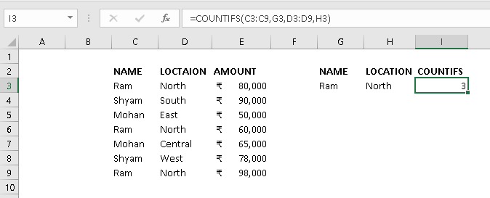
COUNTIFS FUNCTION
The COUNTIFS function applies criteria to cells across multiple ranges and counts the number of times all criteria are met.
SYNTAX: =COUNTIFS(criteria_range1, criteria1, [criteria_range2, criteria2]…)

Slide 8
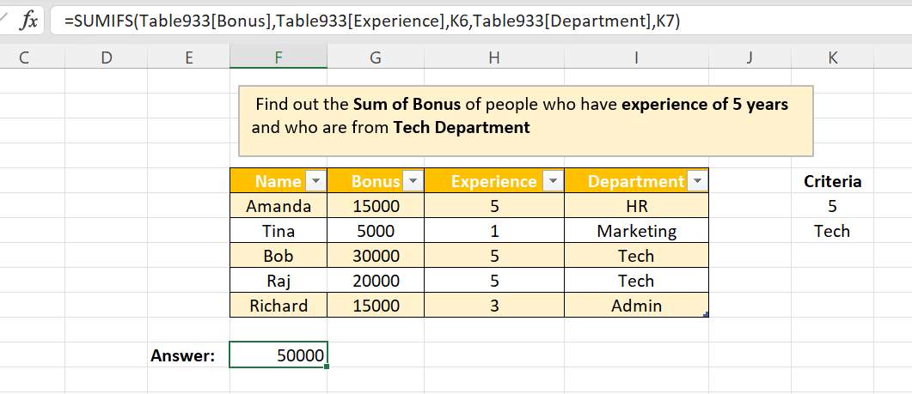
SUMIFS FUNCTION
SUMIFS is a very useful function when you have multiple criteria Instead of adding up all numbers in a range, it lets you sum only those values that meet your criteria.
Syntax: =SUMIFS(sum_range, criteria_range1, criteria1,…)

Slide 9
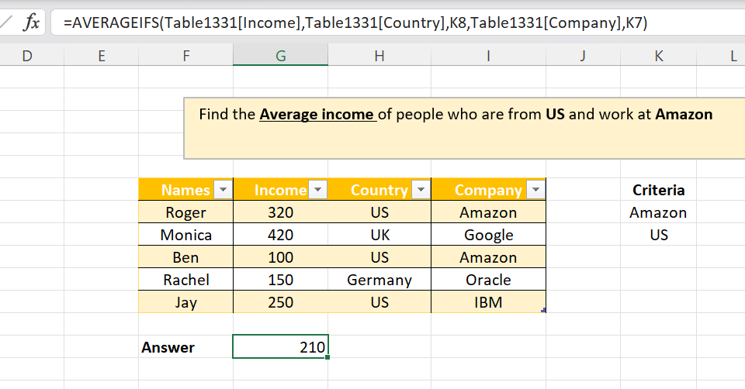
AVERAGEIFS FUNCTION
The AVERAGEIFS function calculates the average of all numbers in a given range of cells, based on multiple criteria.
Syntax: =AVERAGEIFS(average_range, criteria_range1, criteria1,…)

Slide 10
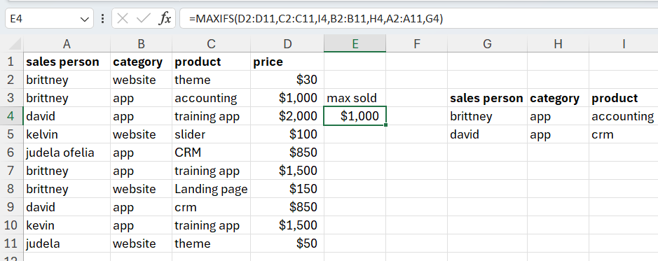
MAXIFS FUNCTION
The MAXIFS function in Excel returns the maximum value among cells specified by a given set of conditions or criteria. It's useful for filtering data and finding the highest value that meets certain conditions.
Syntax: =MAXIFS(max_range, criteria_range, criteria1,….)

Slide 11
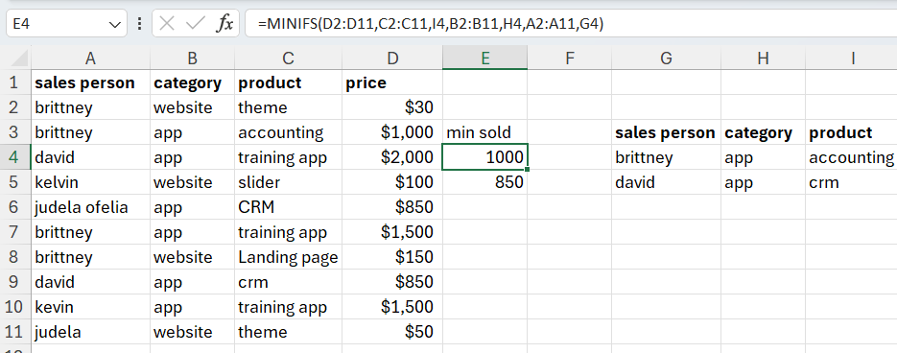
MINIFS FUNCTION
The MINIFS function in Excel returns the minimum value among cells specified by a given set of conditions or criteria. It's useful for filtering data and finding the lowest value that meets certain conditions.
Syntax: =MINIFS(min_range, criteria_range1, criteria1,…)

Slide 12
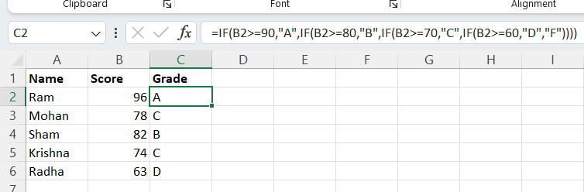
NESTEDIF FUNCTION
Nested IF functions, meaning one if function inside of another IF function, allow you to test multiple criteria and increases the number of possible outcomes.
Syntax: =IF(condition1,result1,IF(condition2,result2,….)

Slide 13
THANK YOU
BY
Avinab singh
avinabsinghkool@gmail.com

